Slide 1

SCS1301 - OPERATING SYSTEM
UNIT – 5
I/O SYSTEM, LINUX & SHELL PROGRAMMING
(FROM THE TOPIC SHELL OPERATION COMMANDS)
Ms. B KEERTHI SAMHITHA
ASSISTANT PROFESSOR
DEPARTMENT OF CSE
SCHOOL OF COMPUTING

Slide 2
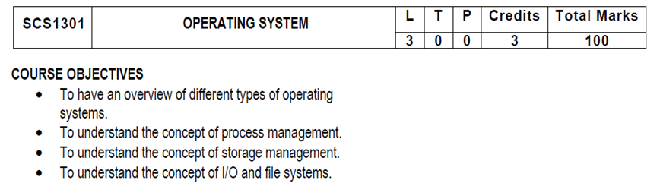
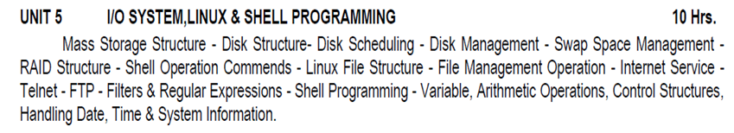
SYLLUBUS

Slide 3
COURSE OUTCOMES
SCS1301.1 | Comprehend knowledge about Operating system components and services.
SCS1301.2 | Apply knowledge of process scheduling algorithms for a given context.
SCS1301.3 | Analyze process synchronization and deadlock conditions.
SCS1301.4 | Construct the process of Mapping logical address to physical address.
SCS1301.5 | Design appropriate strategies for Paging, Segmentation.
SCS1301.6 | Develop real time applications Based on Linux shell programming.

Slide 4
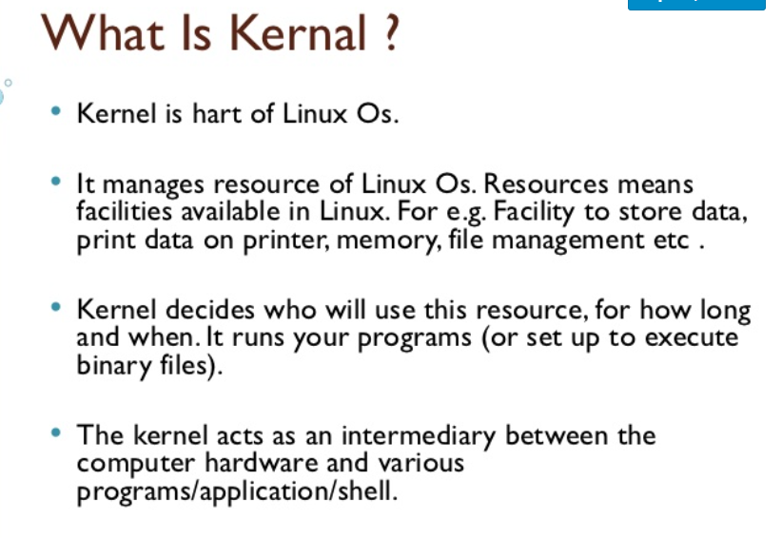
SHELL OPERATION COMMANDS

Slide 5
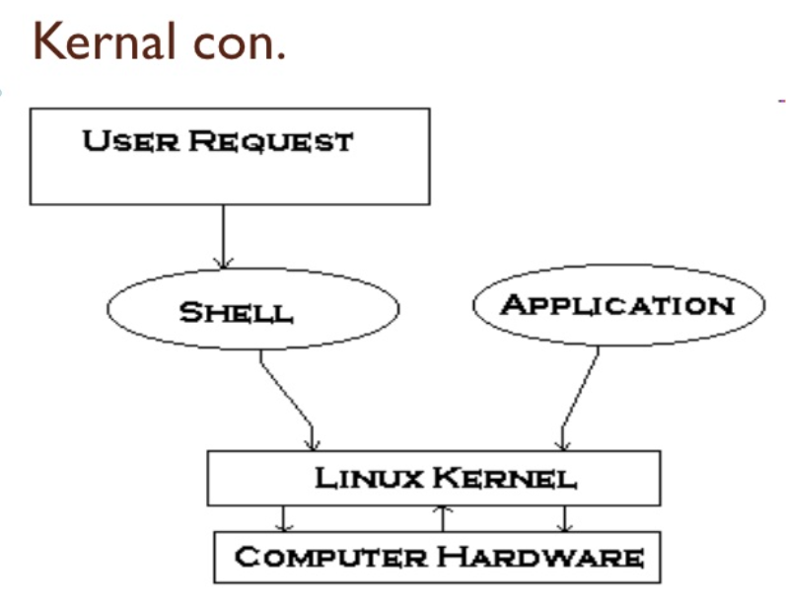
KERNAL

Slide 6
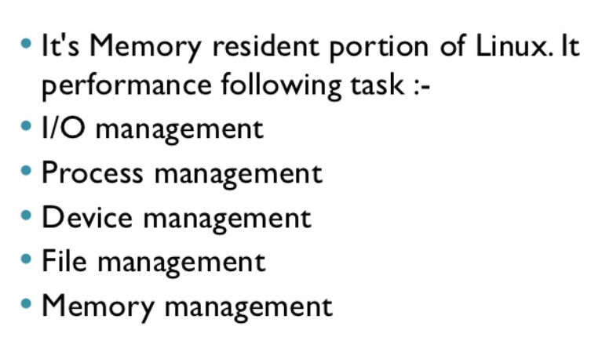
KERNAL

Slide 7
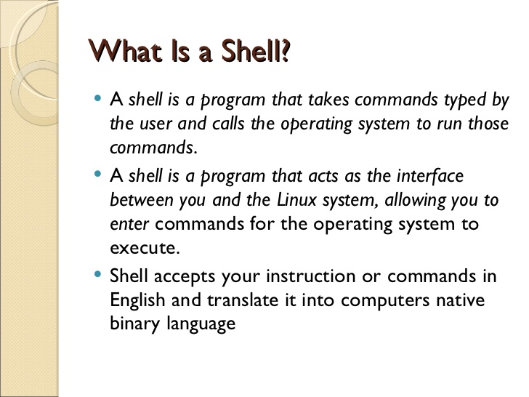

Slide 8
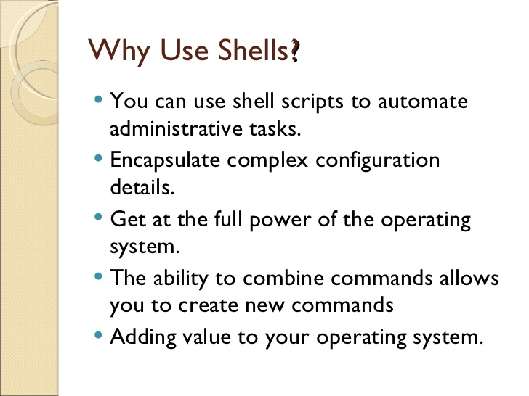

Slide 9
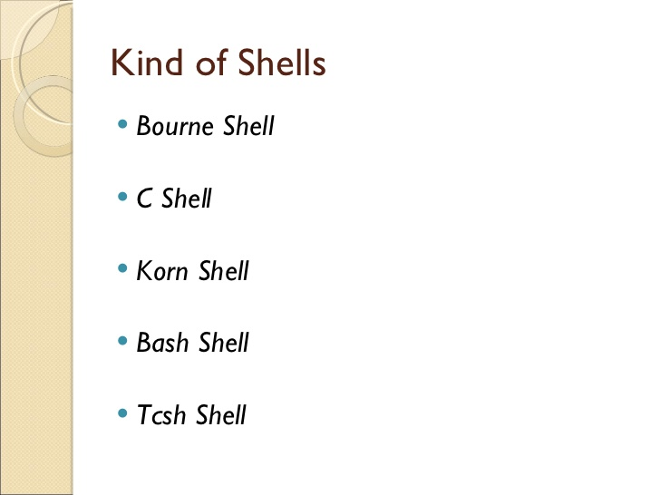

Slide 10
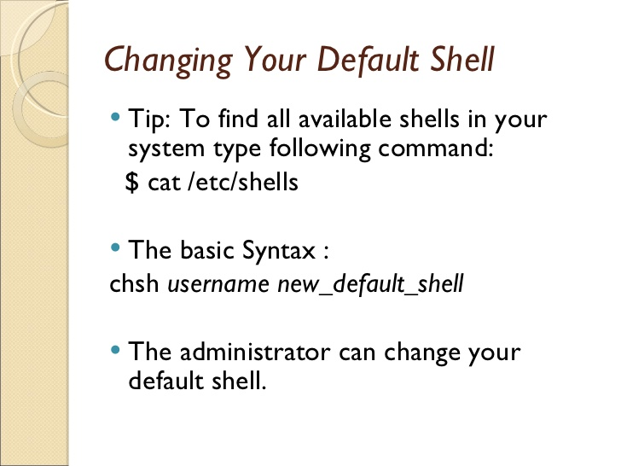

Slide 11
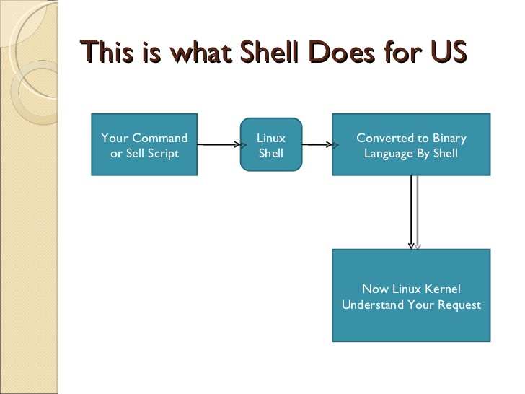

Slide 12
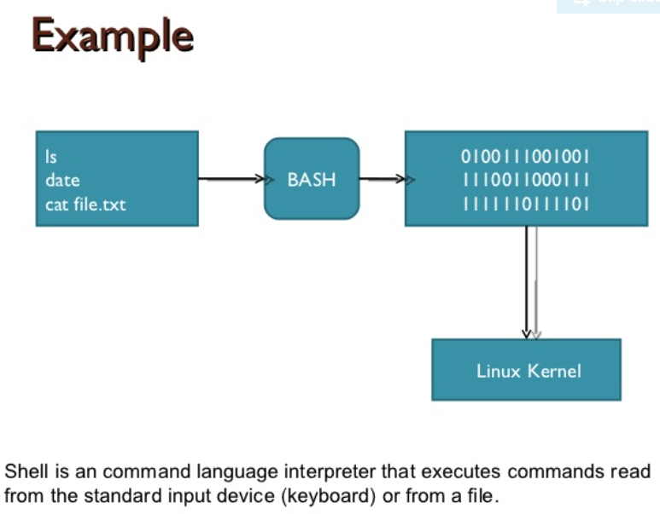

Slide 13
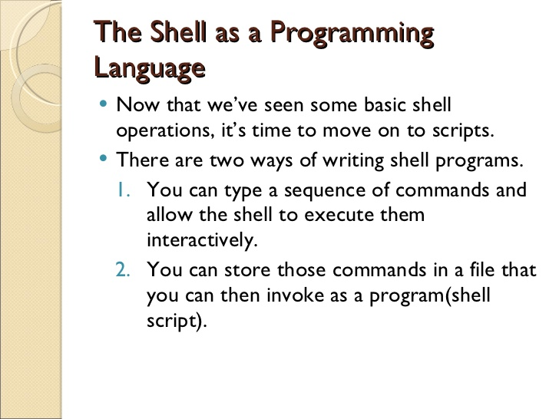

Slide 14
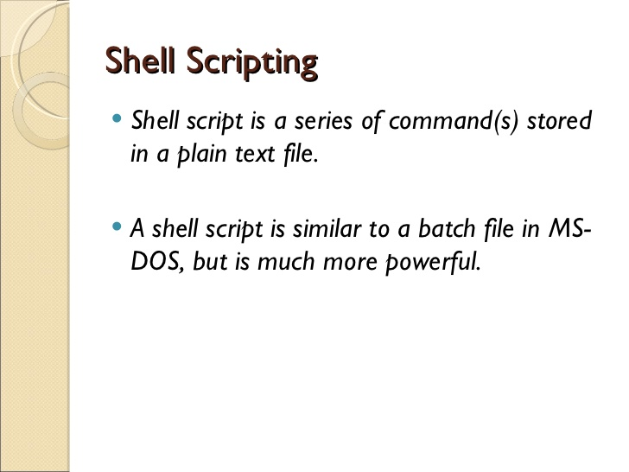

Slide 15
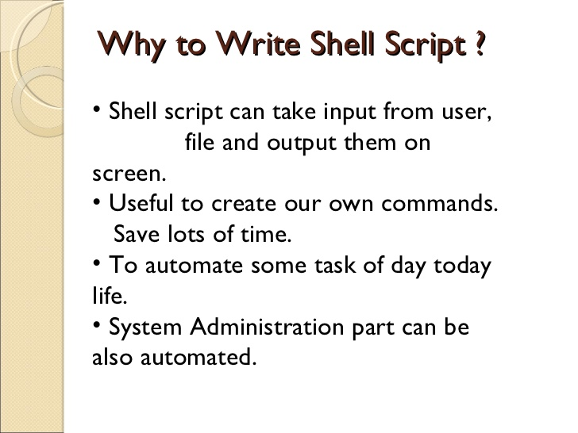

Slide 16
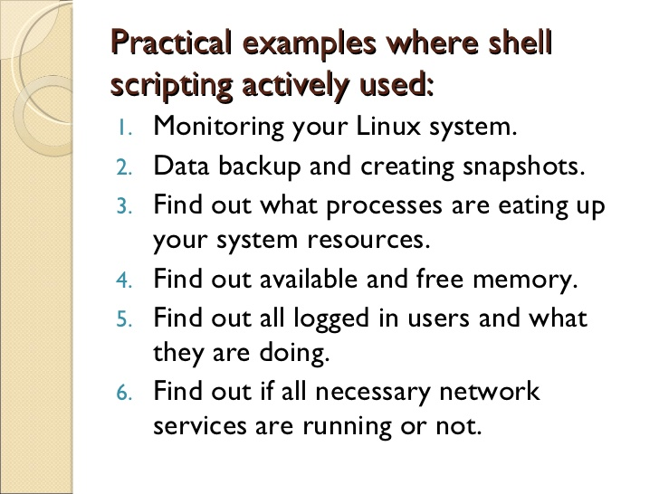

Slide 17
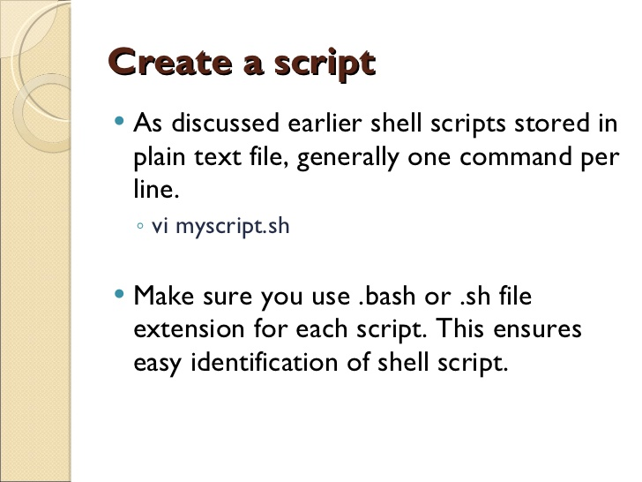

Slide 18
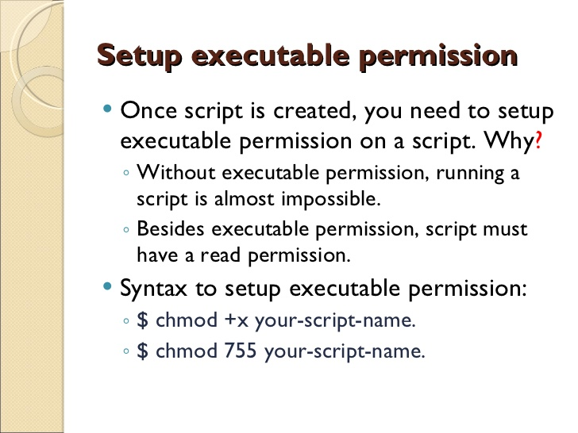

Slide 19
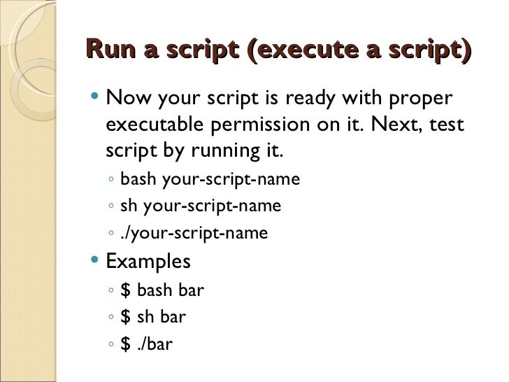

Slide 20
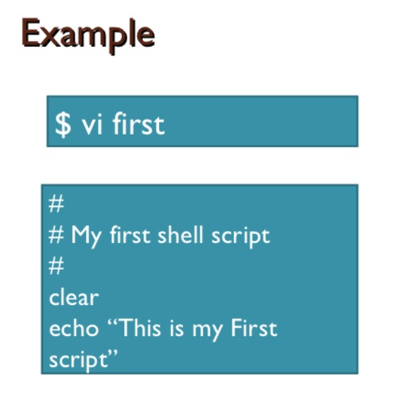
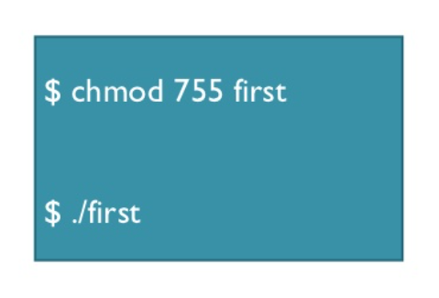

Slide 21
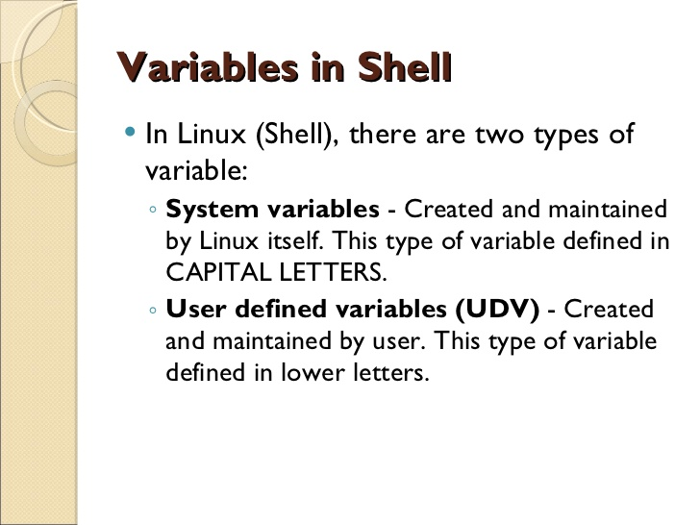

Slide 22
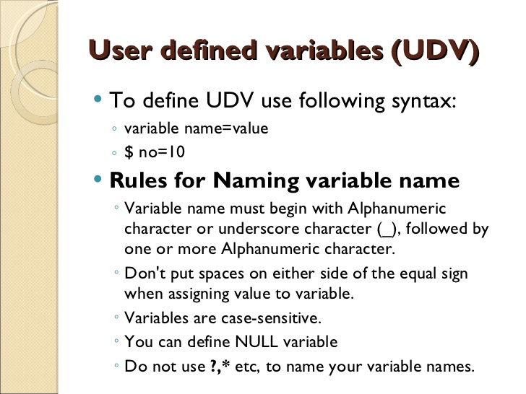

Slide 23
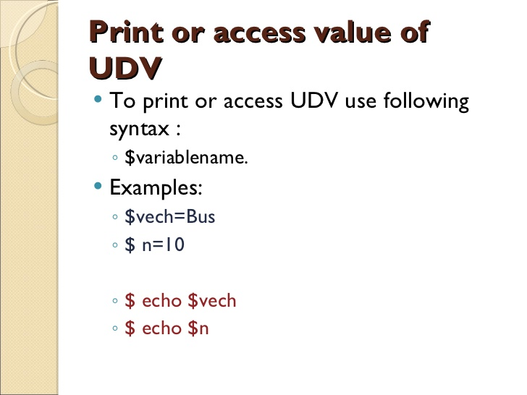

Slide 24
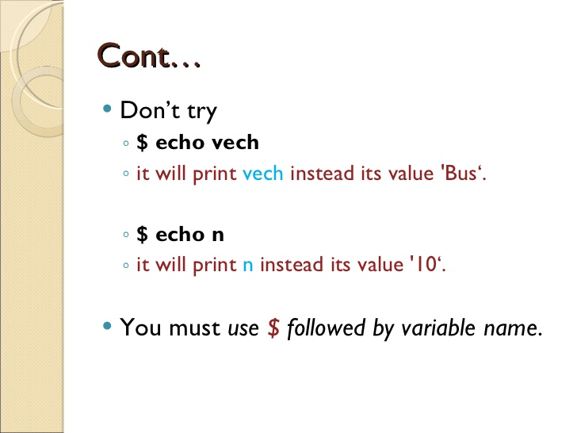

Slide 25
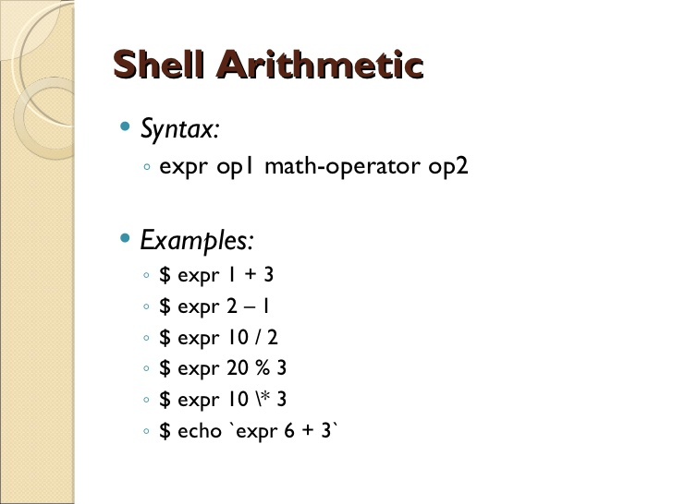

Slide 26
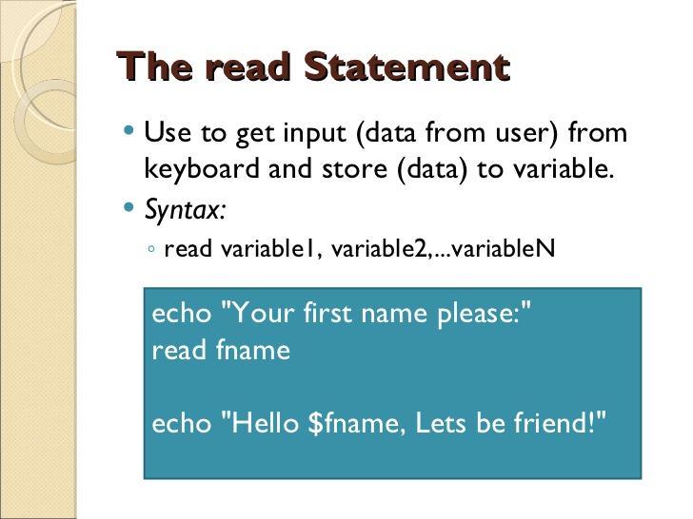

Slide 27
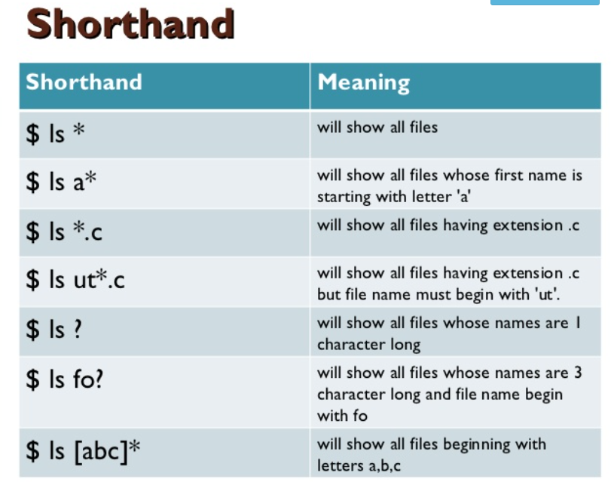

Slide 28
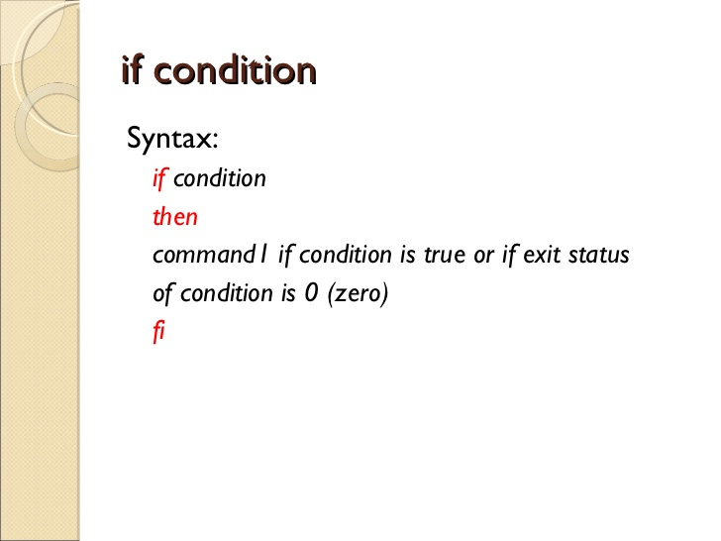

Slide 29
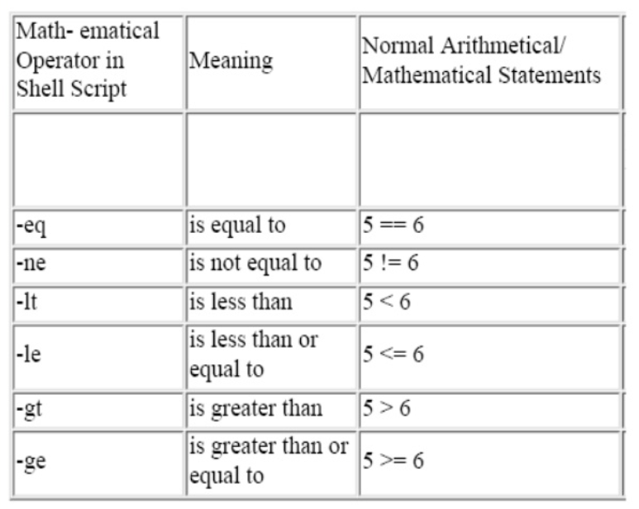

Slide 30
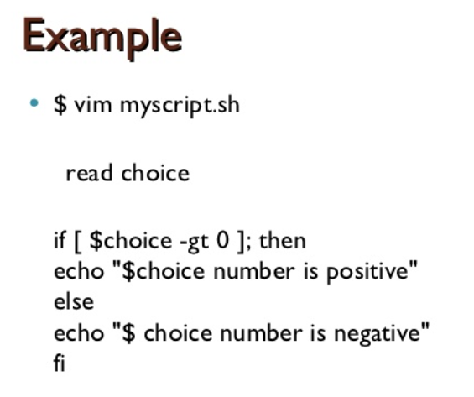
$# Stores the number of command-line arguments that were passed to the shell program.
$? Stores the exit value of the last command that was executed.

Slide 31
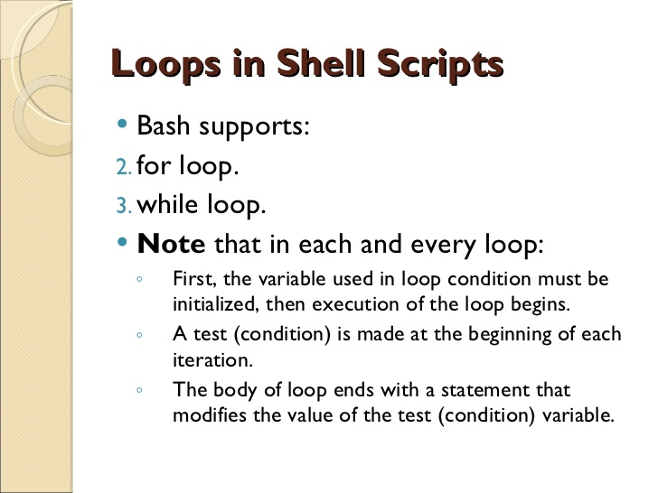

Slide 32
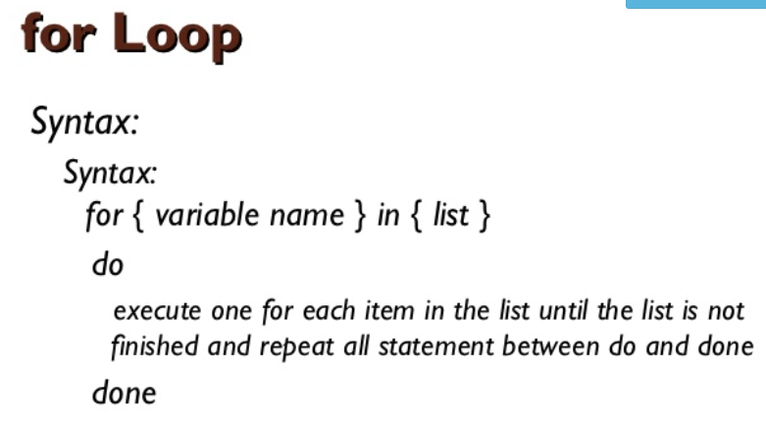

Slide 33
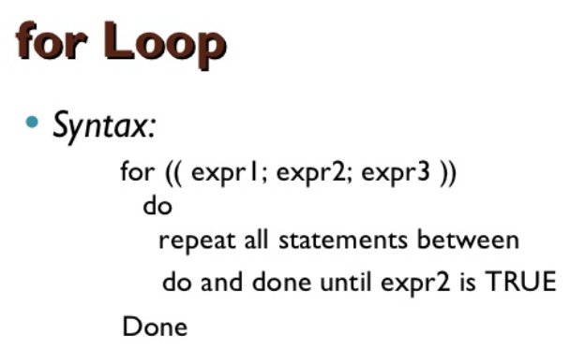
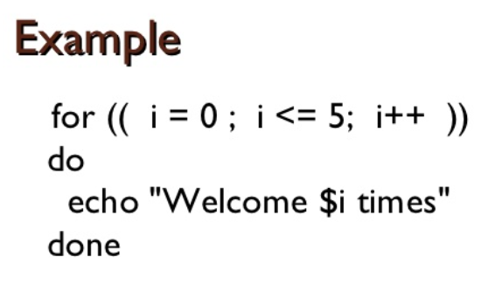

Slide 34
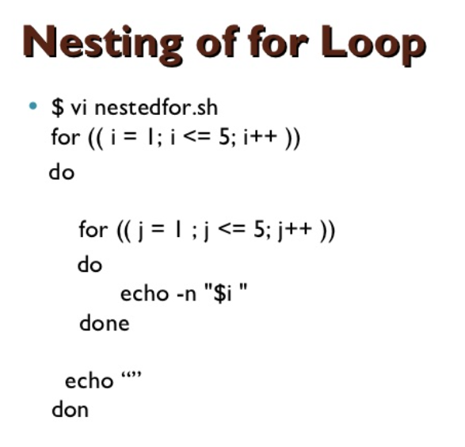

Slide 35
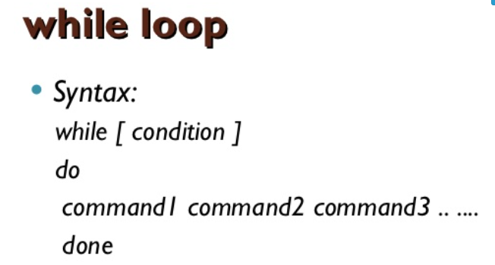
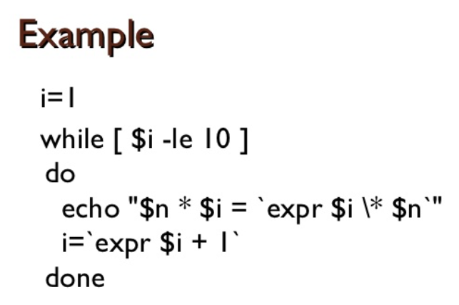

Slide 36
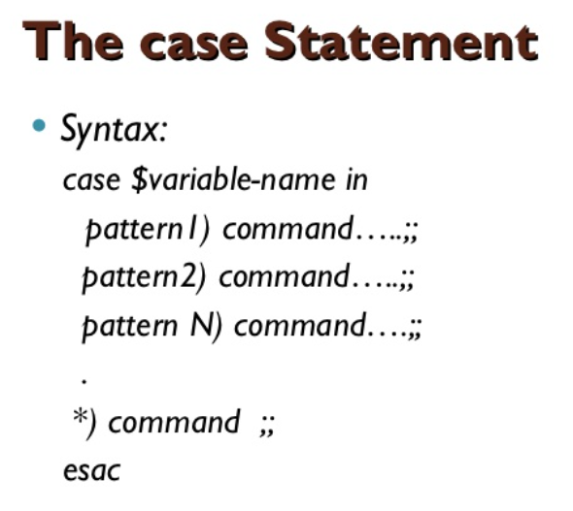
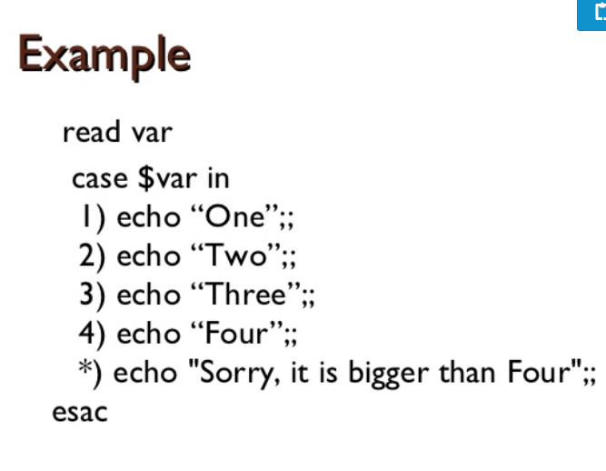

Slide 37
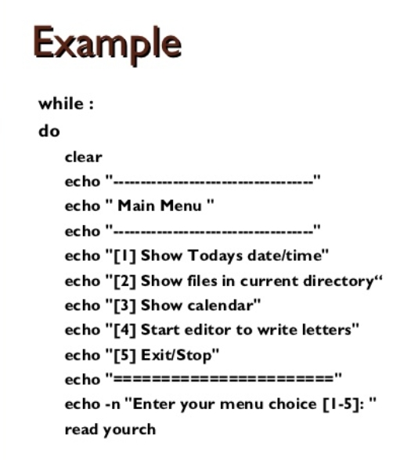

Slide 38
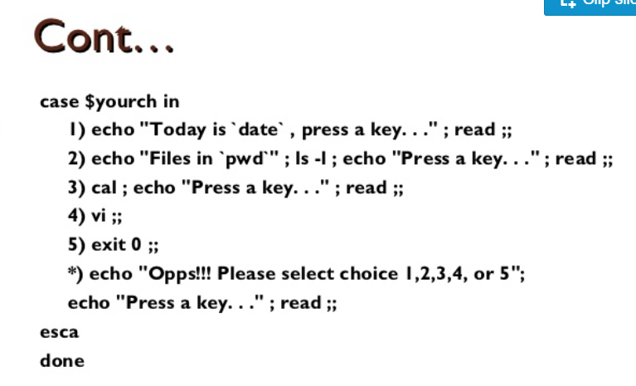

Slide 39
LINUX FILE STRUCTURE
The Linux File Hierarchy Structure or the Filesystem Hierarchy Standard (FHS) defines the directory structure and directory contents in Unix-like operating systems.
It is maintained by the Linux Foundation.
In the FHS, all files and directories appear under the root directory /, even if they are stored on different physical or virtual devices.
Some of these directories only exist on a particular system if certain subsystems, such as the X Window System, are installed.
Most of these directories exist in all UNIX operating systems and are generally used in much the same way; however, the descriptions here are those used specifically for the FHS, and are not considered authoritative for platforms other than Linux.

Slide 40
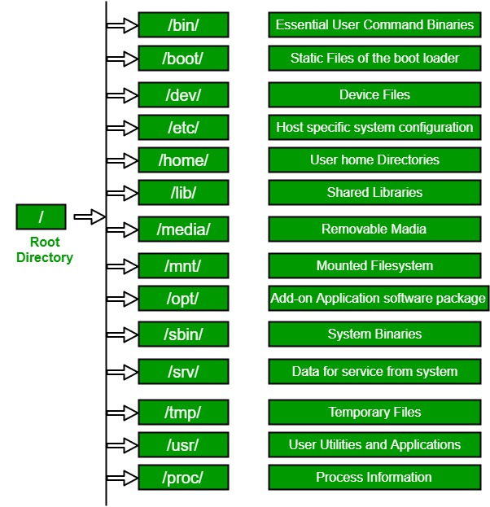

Slide 41
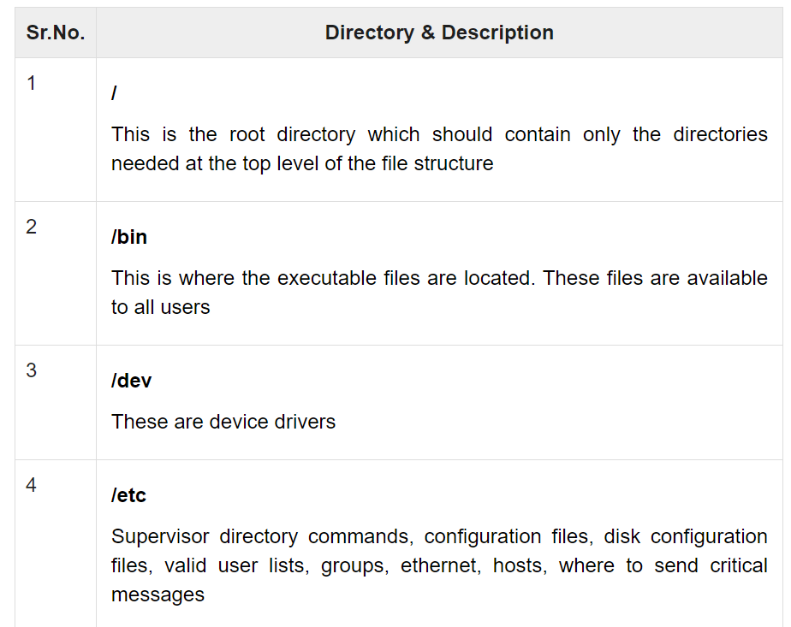

Slide 42
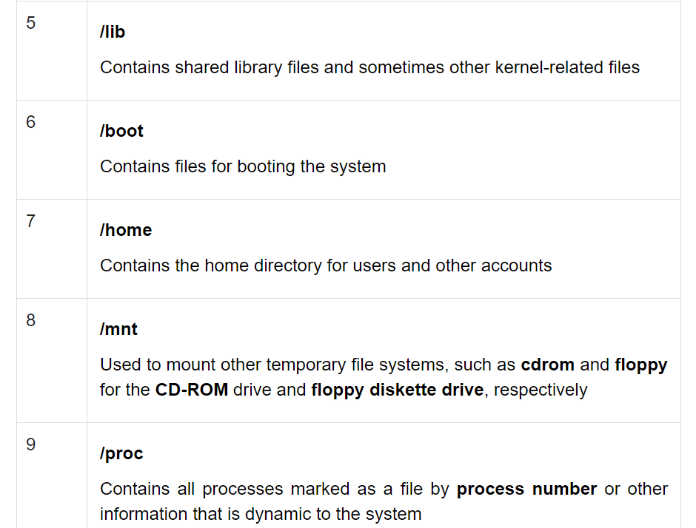

Slide 43
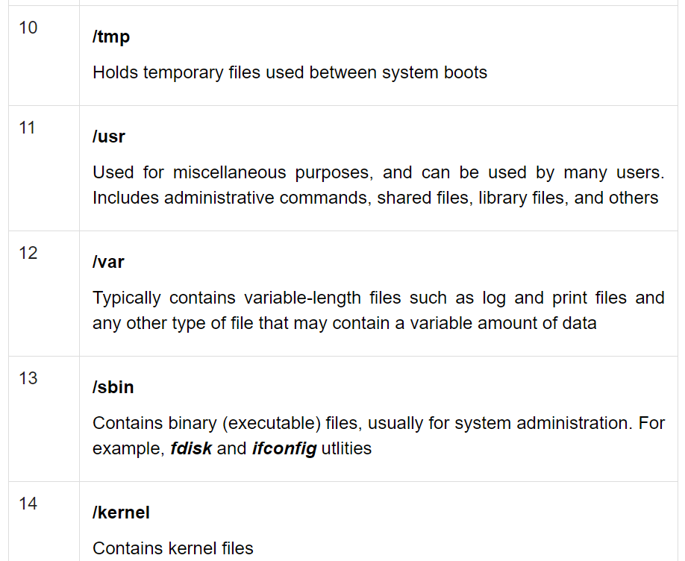

Slide 44
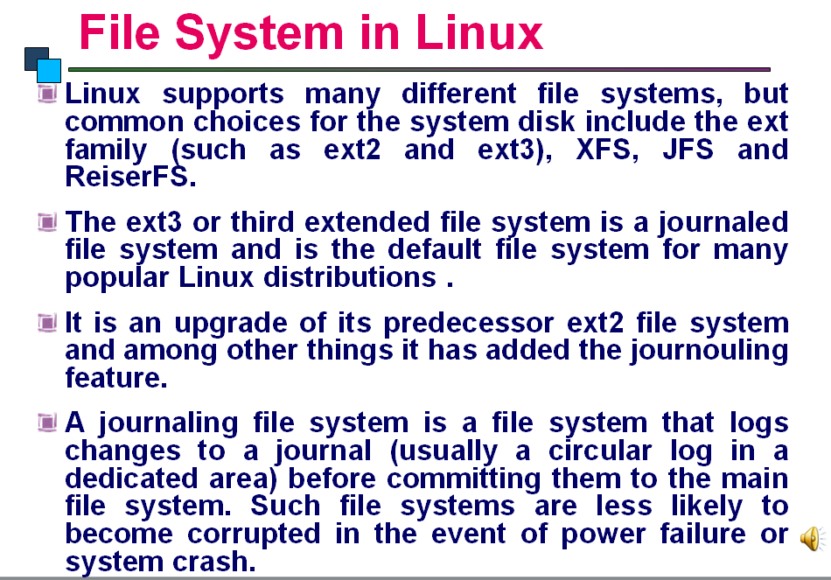

Slide 45
